Slide 1
Wardrobe categorization
Domain: Artificial Intelligence with python
Prepared and Submitted for Internship Review
By: Ch. V. N. S. Sai Divyesh
19JN1A0524
IV B. Tech CSE-A
SVCN

Slide 2
abstract
Machine learning and deep learning, as one of the most prominent fields of today are quickly improving many aspects of our life. One of the categories that provides strongest results in resolving real-world problems is Convolutional Neural Networks (CNN). Fashion industries have been using Convolutional Neural Networks in e-commerce to solve several problems such as, clothing recognition, clothing searches and recommendations. However, the conventional CNN suffers from several issues including model overfit issues, challenging classification and difficult deep division of garment. It is precisely this complex depth that allows multiple classes to have the same characteristics, making the problem of separation more complex. With this paper, the state-of-art algorithms for the classification of images in the FASHION MNIST database are targeted. Convolutional neural network structures based on deep learning are employed for image classification of the MNIST dataset. The study aims to tackle the model overfit issue, using two different convolutional neural networks CNN-C1 and CNN-C2 architectures to determine which one provides better performance and results. The results show that compared with conventional deep neural network the CNN-C2 outperforms the CNN-C1 architecture and produces higher accuracy of 93.11%.

Slide 3
ide used in project
Google Collab:
Visit www.colab.research.google.com.
Sign-in with your Google Account.
Click on File button and create New Notebook where you can start executing your Python code.
You don’t need to install any modules to run any code.
You can share your Google Collab notebooks very easily with anyone.

Slide 4
Technologies used in project
Artificial Intelligence: The Turing Test, proposed by Alan Turing (1950) was designed to provide a satisfactory definition of AI. The computer would need to possess the following capabilities:
Machine Learning: This is often the foundation for an AI system, and is the way we “teach” a computer model to make prediction and draw conclusions from data. Some of the libraries used in Python to perform ML tasks are:
Anomaly Detection: The capability to automatically detect errors or unusual activity in a system.
Natural Language Processing: The capability of a computer to interpret written or spoken language, and respond accordingly. Scikit-learn is the best library in Python used to perform NLP.
Computer Vision: The capability of software to interpret the world visually through cameras, videos and images. OpenCV is the best library in Python used to perform computer vision.

Slide 5
Technologies used in project
Machine learning: Machine Learning is an application of AI that provides systems the ability to automatically learn and improve from experience without being explicitly programmed.
Simply, ML is a technique of converting information into knowledge.
Machine Learning is generally classified into 3 types:
Supervised Learning
Unsupervised Learning
Reinforcement Learning

Slide 6
Technologies used in project
Computer Vision: Computer vision is a field of artificial intelligence (AI) that enables computers and systems to derive meaningful information from digital images, videos and other visual inputs and take actions or make recommendations based on that information. Two essential technologies are used to accomplish this: a type of machine learning called Deep Learning and a Convolutional Neural Network (CNN).
Machine Learning uses algorithmic models that enable a computer to teach itself about the context of visual data. Algorithms enable the machine to learn by itself, rather than someone programming it to recognize an image.

Slide 7
Technologies used in project
A CNN helps a machine learning or deep learning model “look” by breaking images down into pixels that are given tags or labels. It uses the labels to perform convolutions (a mathematical operation on two functions to produce a third function) and makes predictions about what it is “seeing.”

Slide 8
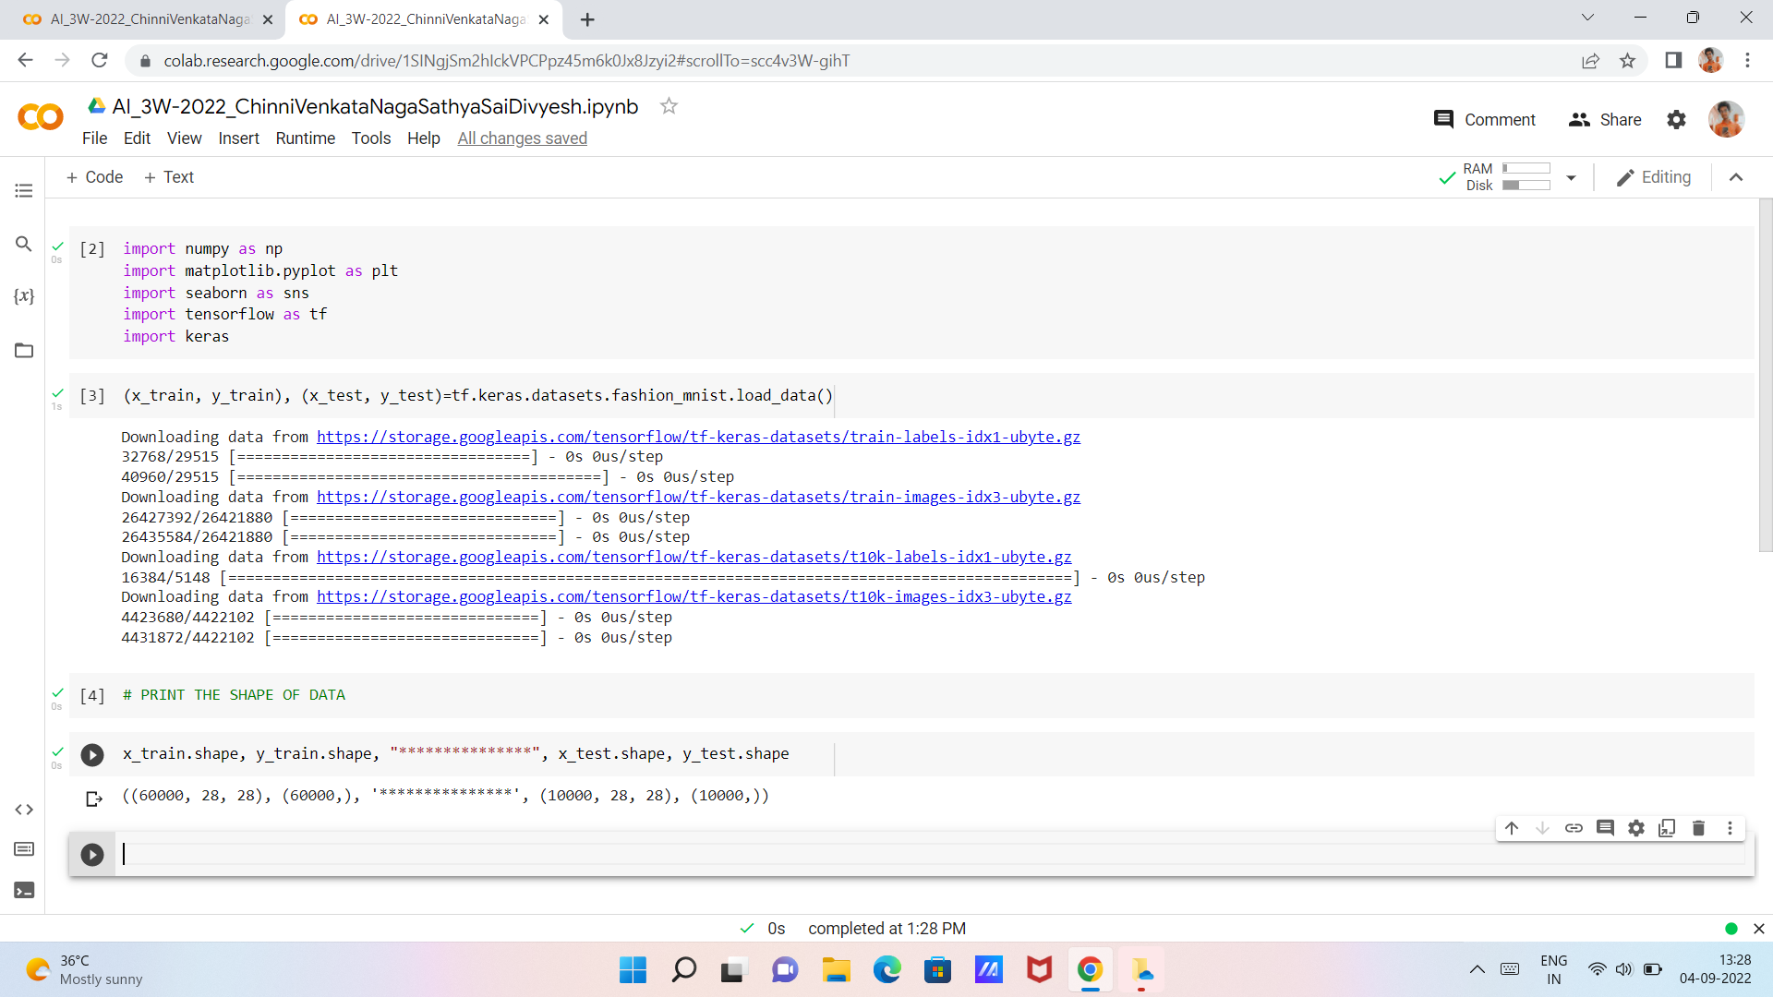
Overview of code
Import the required libraries and print the shape of data

Slide 9
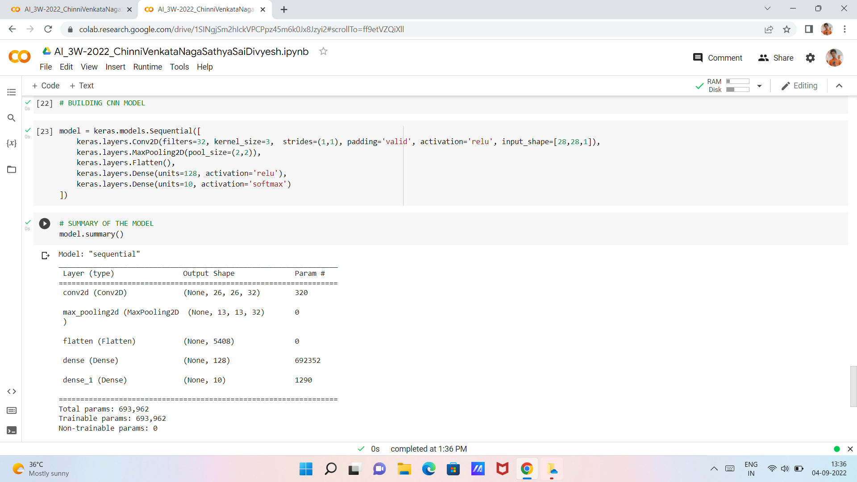
Overview of code
Build the CNN Model

Slide 10
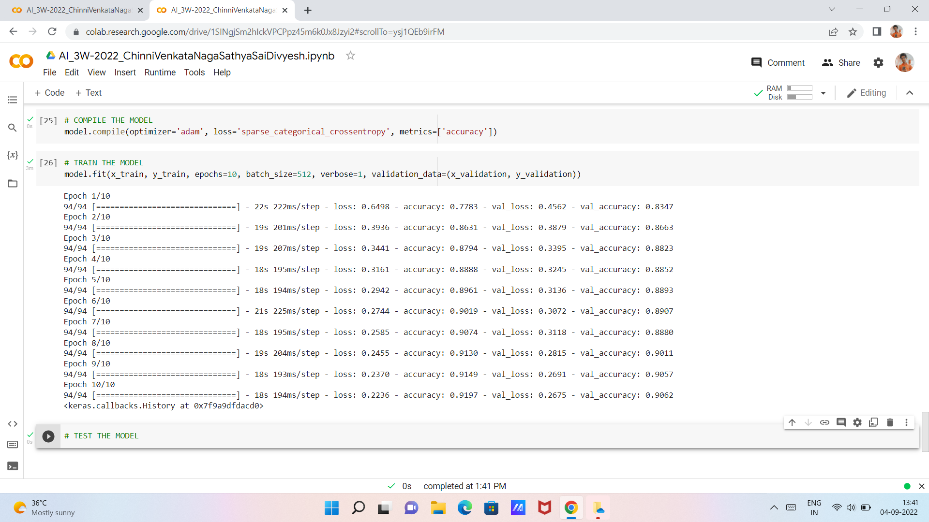
Overview of code
Compile and Train the Model

Slide 11
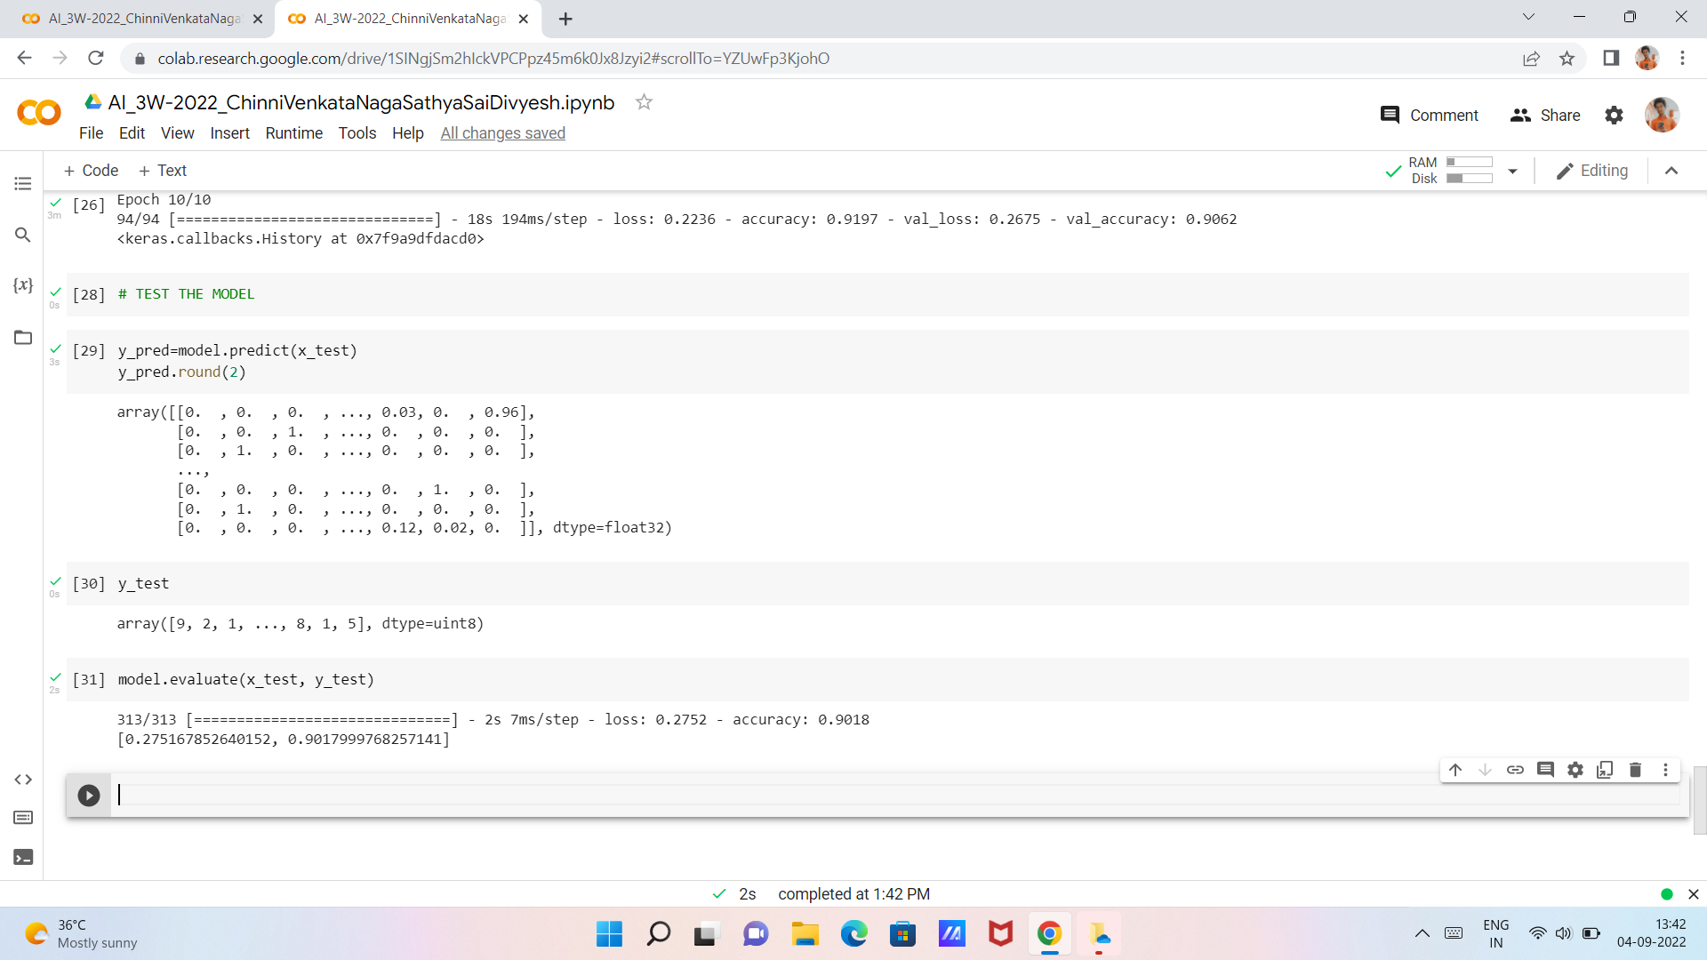
Overview of code
Test the Model

Slide 12
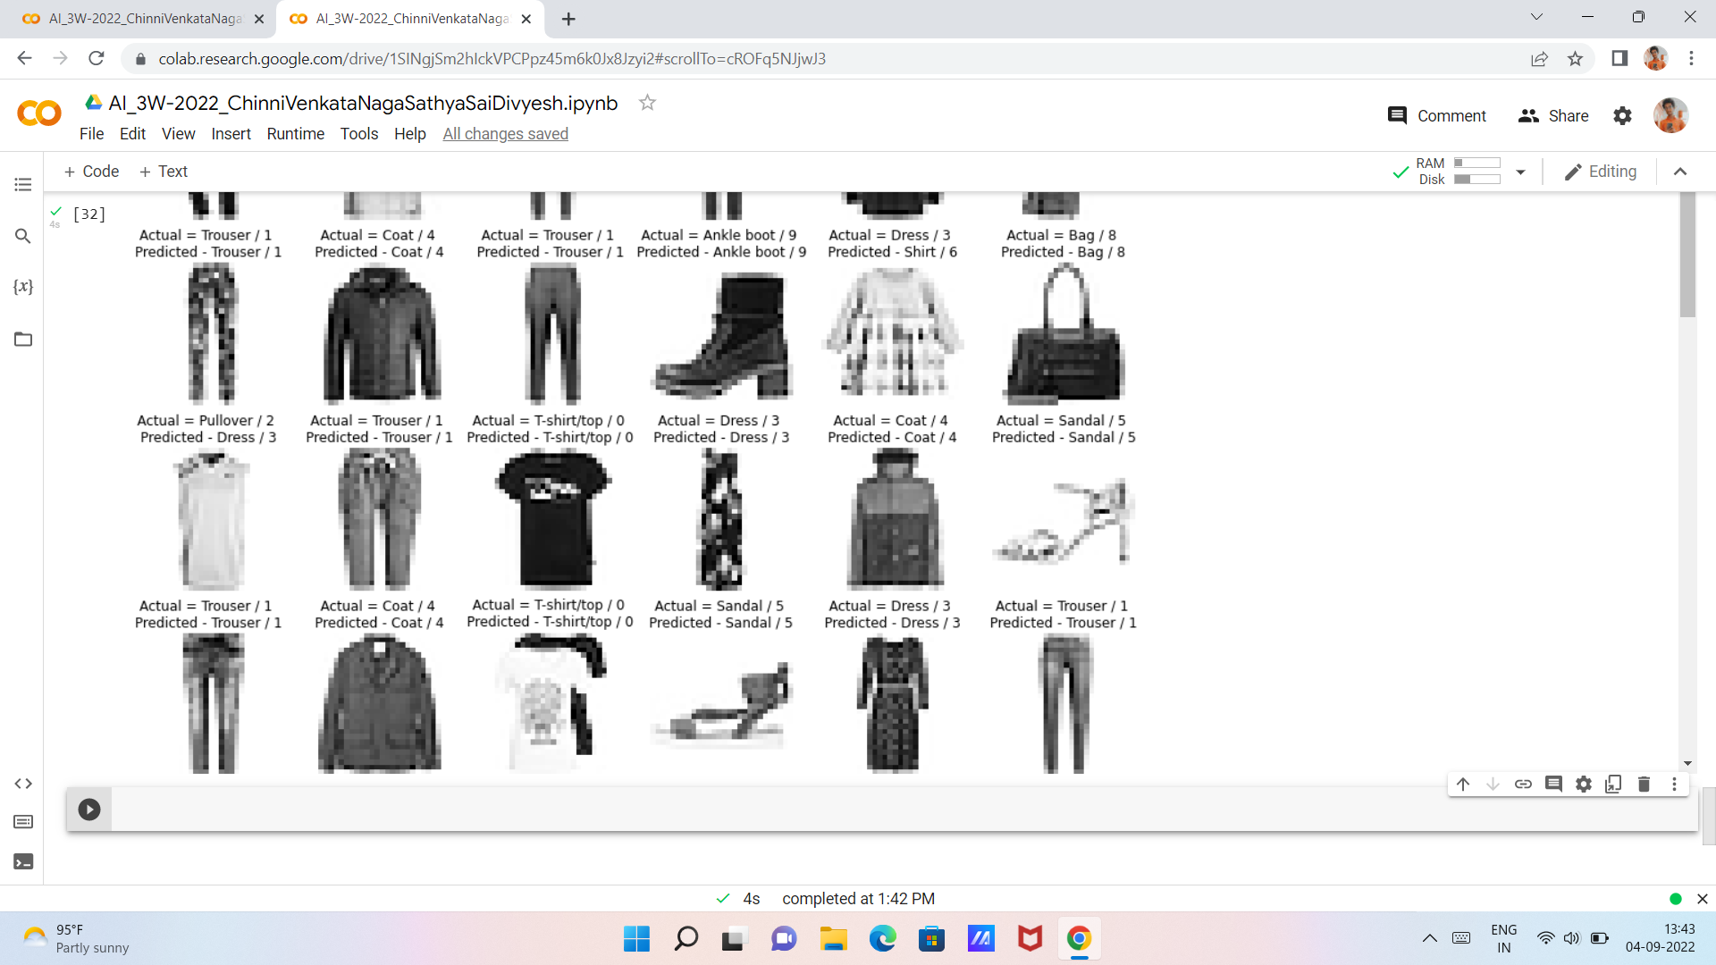
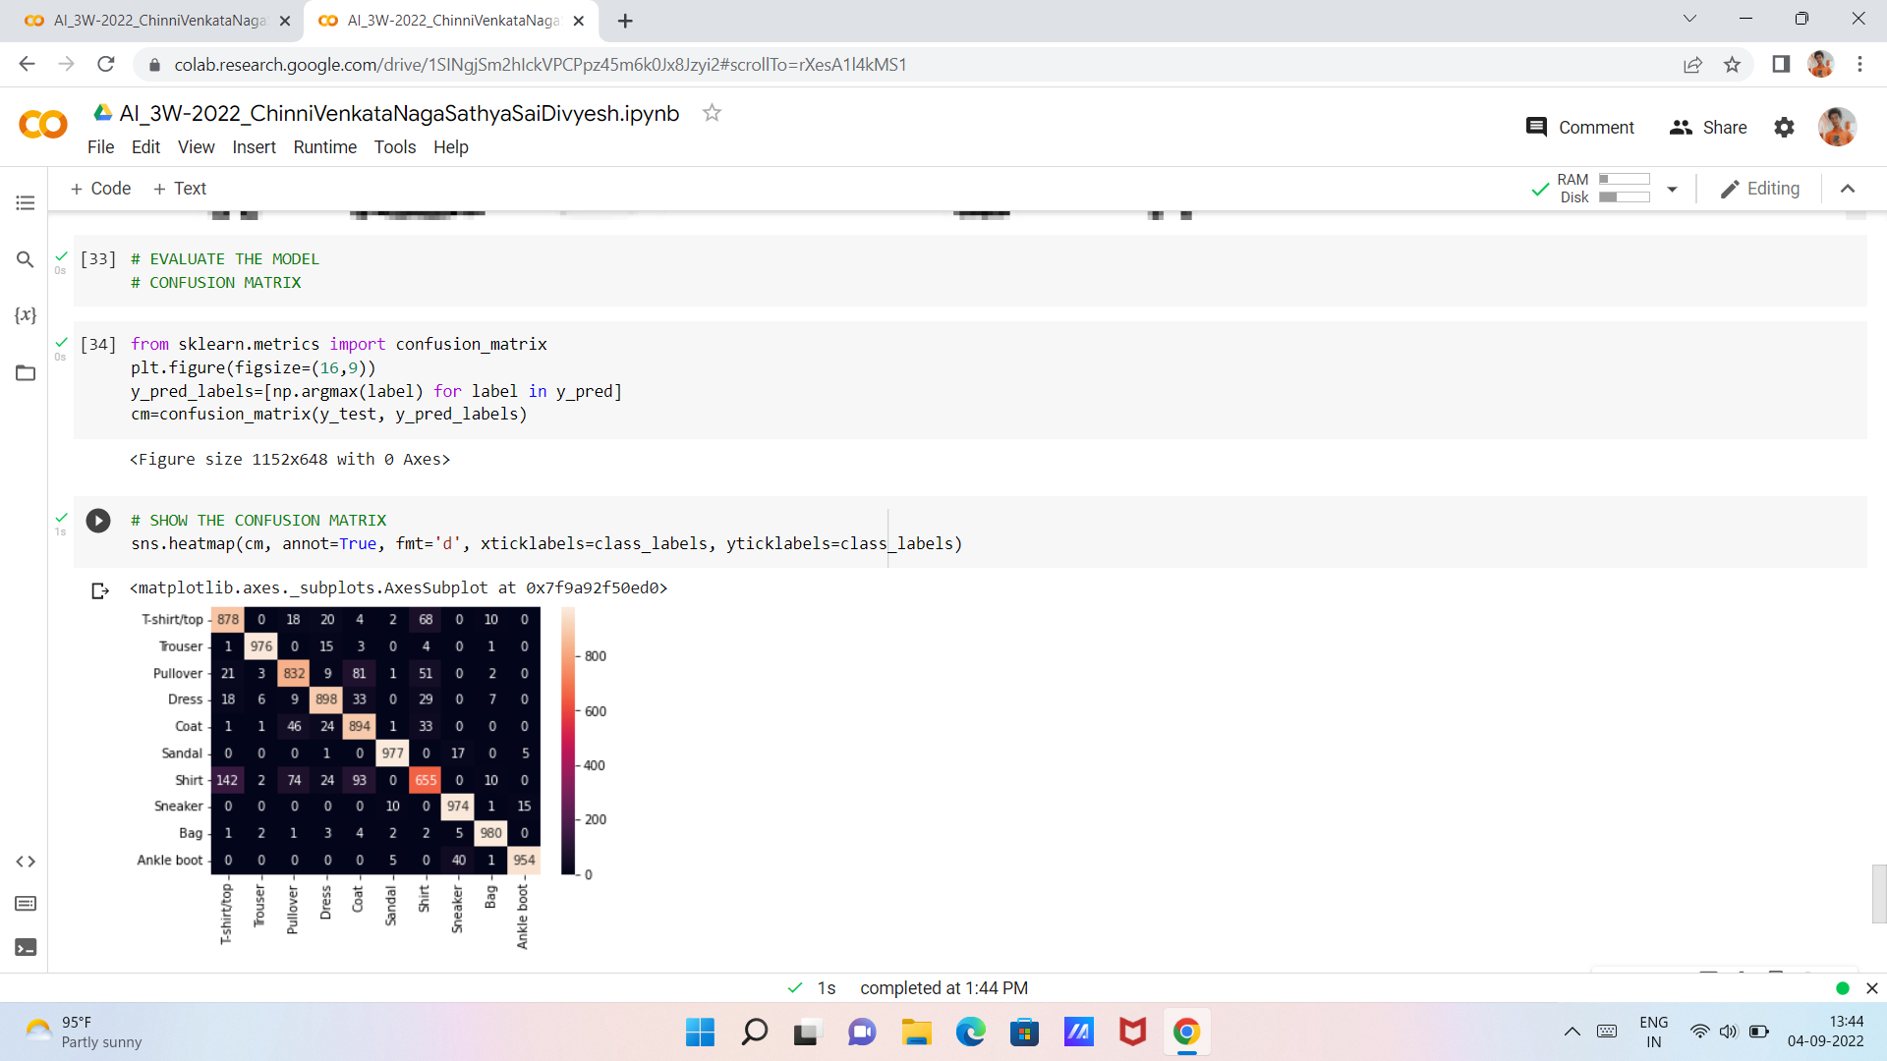
Outputs of code
Display 60 random images as output
Evaluate Model using Confusion Matrix

Slide 13
conclusion
Artificial Intelligence and Machine Learning are trending topics in today’s time. While developers are passionately trying to learn it, it is crucial to be familiar with the solutions. Python plays a head of table when it comes to AI.
Python provides the benefit of a reasonable code. AI and ML require solving complex algorithms. However, the simplicity of Python will ensure that developers can easily write the codes.

Slide 14
references
E. Xhaferra, E. Cina and L. Toti, "Classification of Standard FASHION MNIST Dataset Using Deep Learning Based CNN Algorithms," 2022 International Symposium on Multidisciplinary Studies and Innovative Technologies (ISMSIT), 2022. URL: https://ieeexplore.ieee.org/stamp/stamp.jsp?tp=&arnumber=9932737&isnumber=9932651
Keras Datasets Website: https://keras.io/api/datasets/
Kaggle Datasets Website: https://www.kaggle.com/datasets/zalando-research/fashionmnist

Slide 15
Thankyou

